Slide 1
Lecture 1.7 - Example Data Science Project 2: NetProbe Auction Fraud Detection
DLI Accelerated Data Science Teaching Kit

Slide 2

The Accelerated Data Science Teaching Kit is licensed by NVIDIA, Georgia Institute of Technology, and Prairie View A&M University under the
Creative Commons Attribution-NonCommercial 4.0 International License.

Slide 3
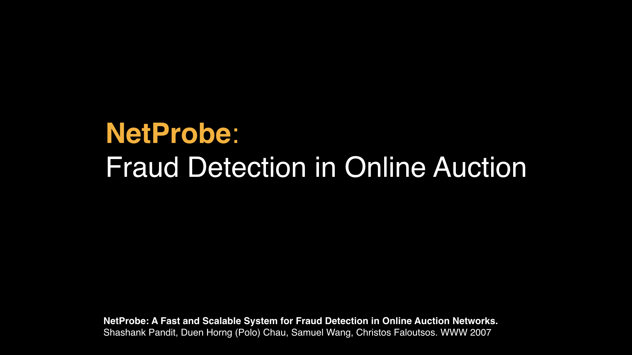

Slide 5
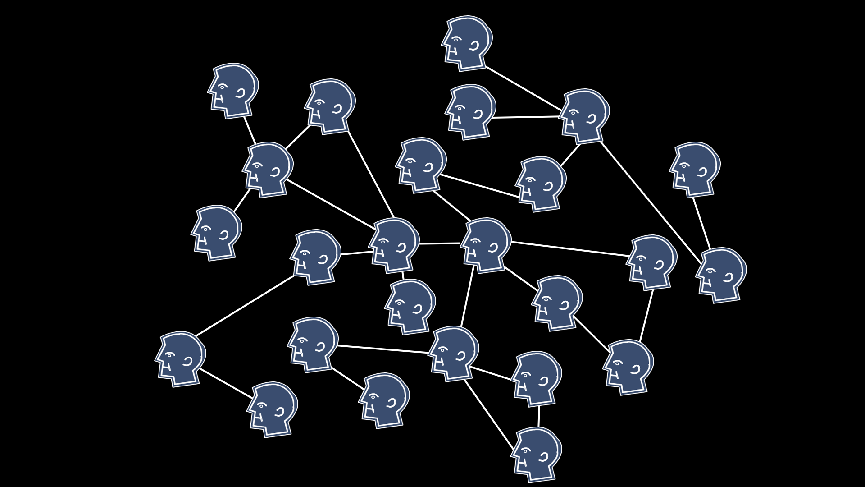

Slide 6
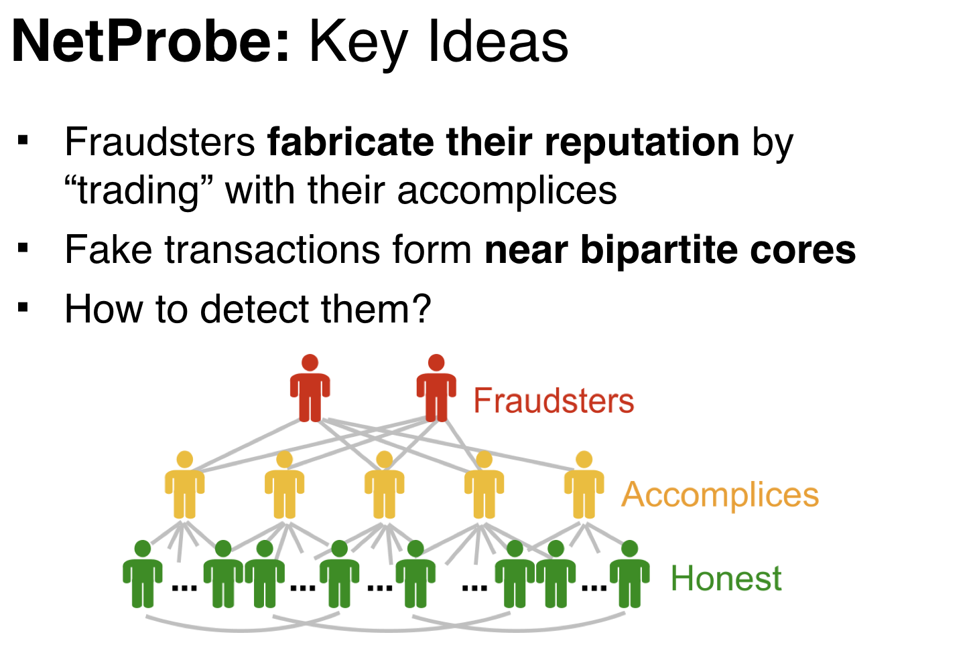

Slide 7
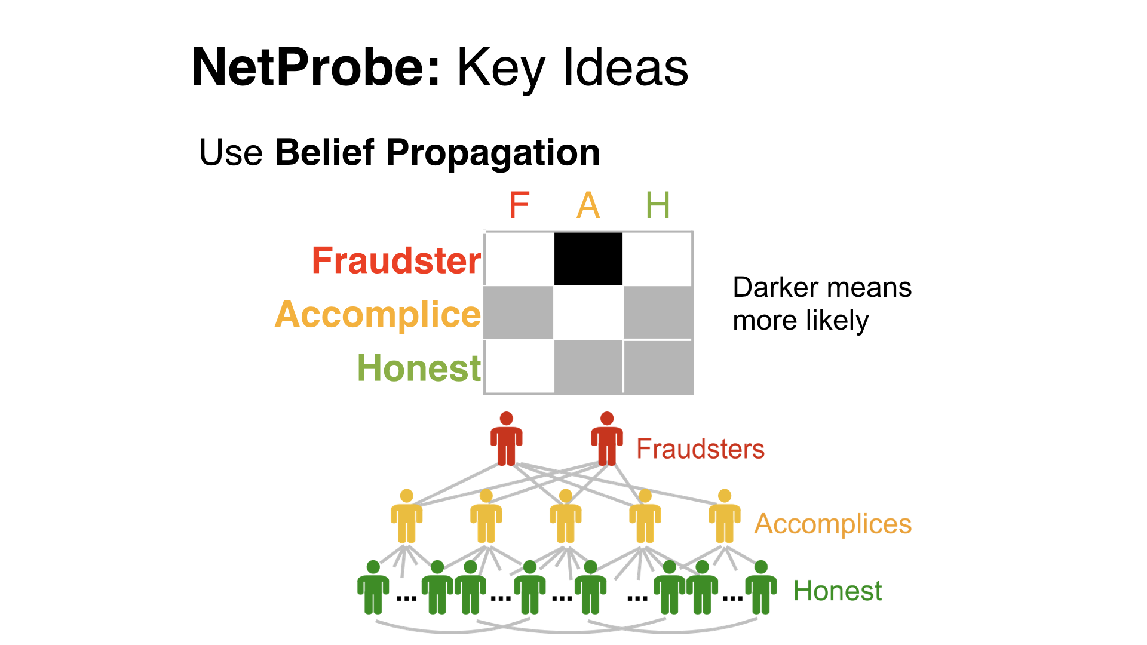


Slide 8
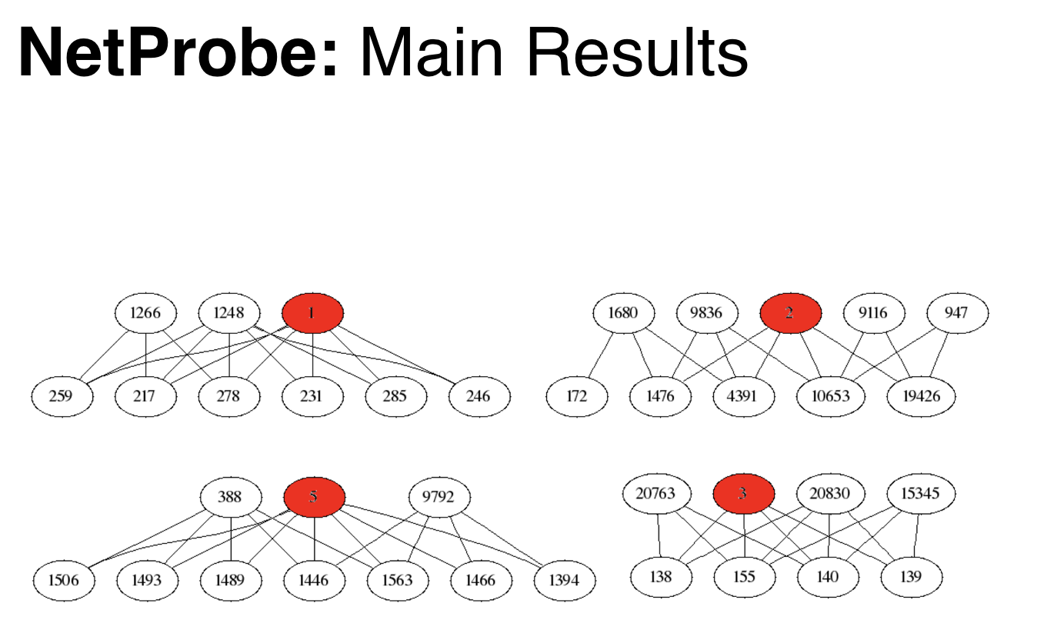

Slide 9
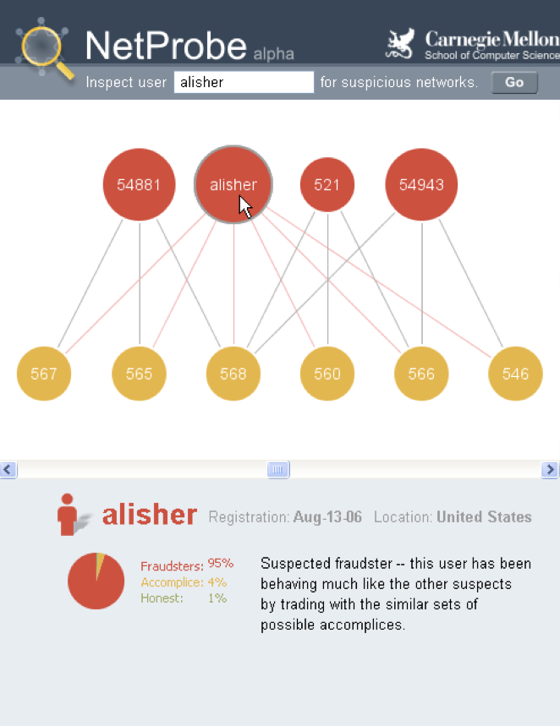

Slide 10
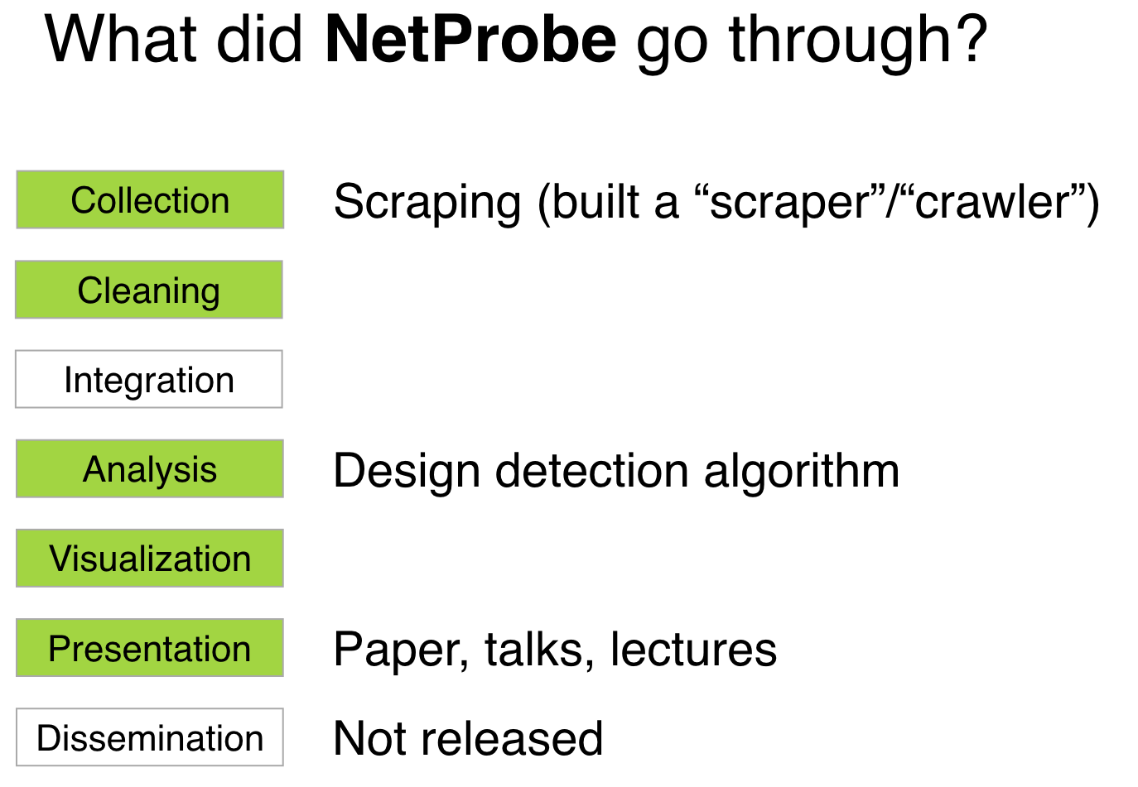

Slide 11
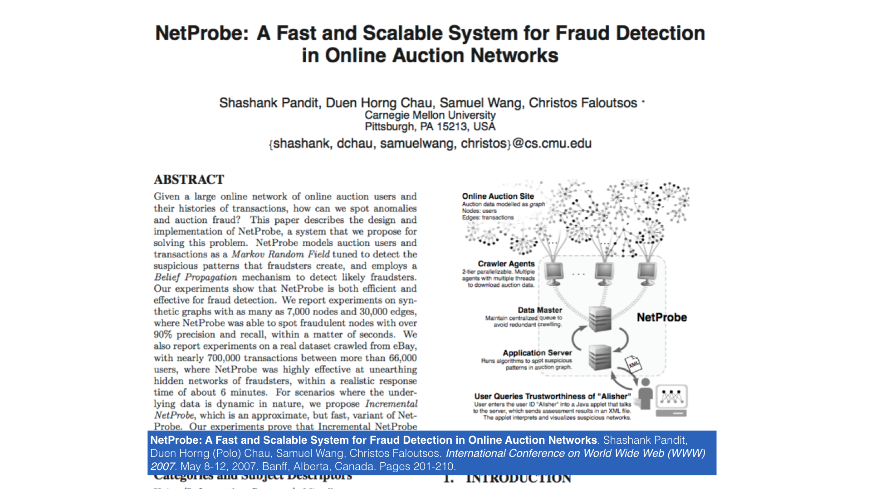

Slide 12
DLI Accelerated Data Science Teaching Kit
Thank You

